Slide 1
“Let’s Walk and Let’s Talk: Physical and Spiritual”
Felice Wicks

Slide 2
The influence of a Minister’s wife
Etiquette and fashion
Marriage
Parenting
Church and Community

Slide 3
The Success of a minister’s wife
Depends upon her
1. Physical and
2. Spiritual Health

Slide 4
In the Beginning
Genesis 1:1

Slide 5
And on the seventh day god ended His work….and he rested…​
Genesis 2:2

Slide 6
God’s Instruction manual 1. REST – Gen. 2:3; Exodus 20:8-11 2. Proper Diet – Gen. 1:29, 9:3; I Tim. 4:4-5 3. exercise – I Cor. 6:9-10; Proverbs 31:17 4. Me Time – Bible Verse??
Let’s Walk and Let’s Talk: Physical and Spiritual

Slide 7
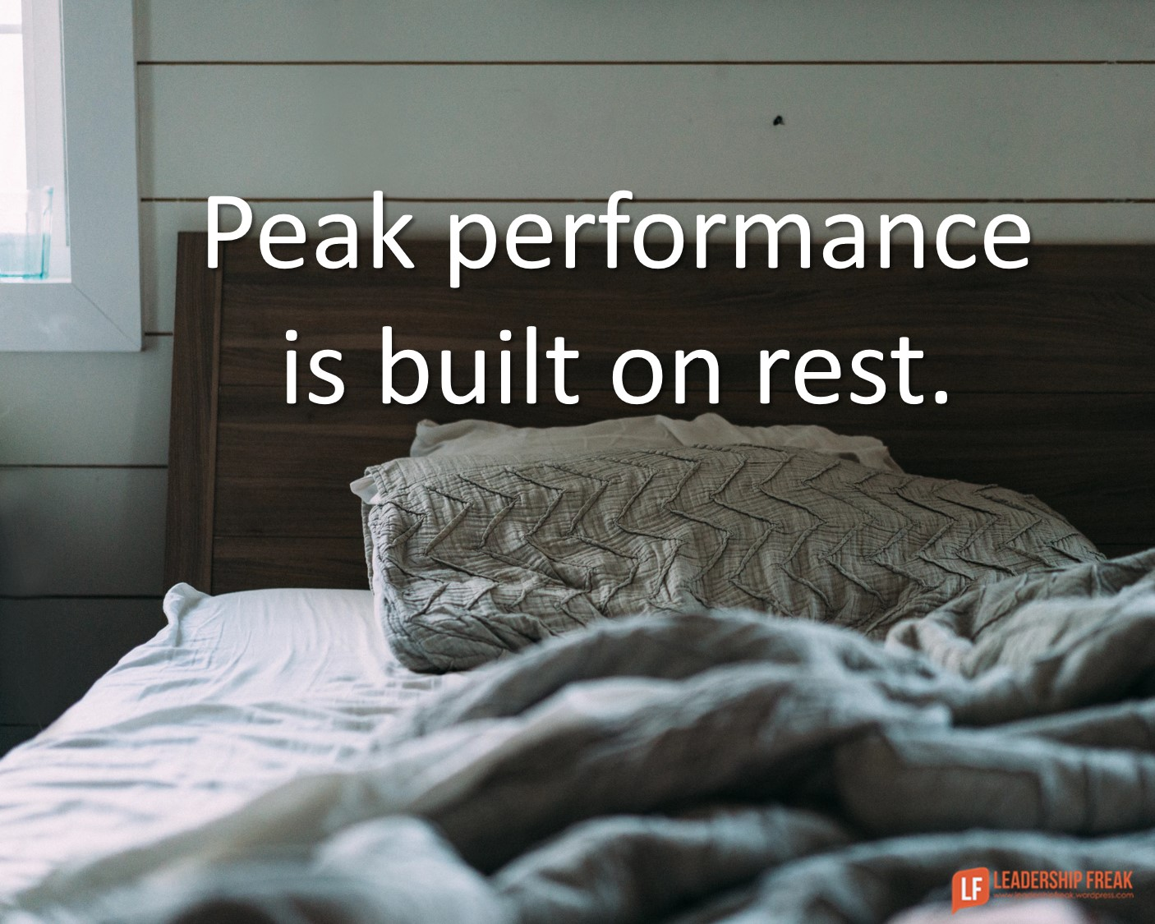
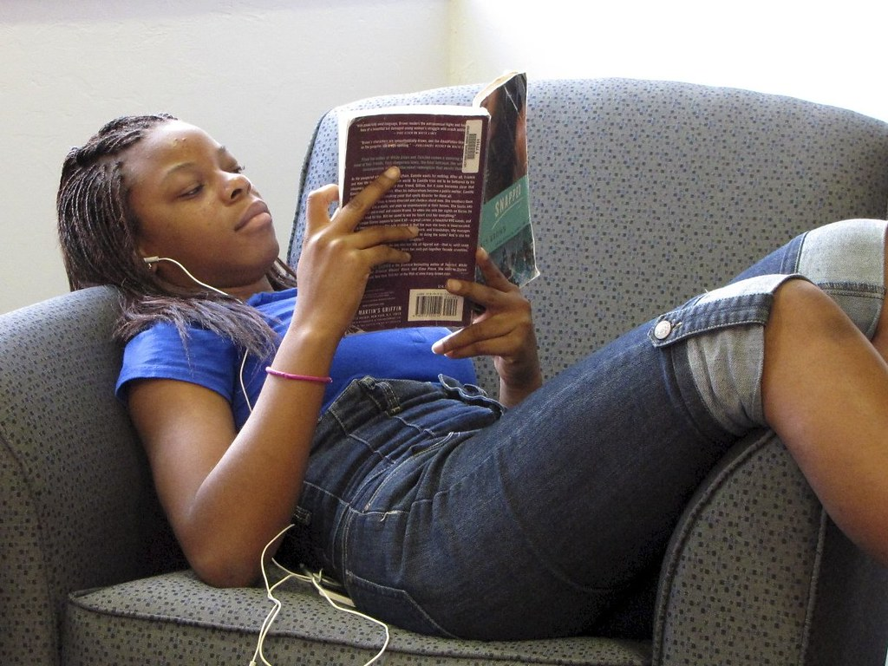
Our physical health
REST
DIET
EXERCISE
ME TIME
Jesus Did!
Eat to Live.
Clears Your Mind.
Self-care
This Photo by Unknown Author is licensed under CC BY
This Photo by Unknown Author is licensed under CC BY-SA-NC

Slide 8
Rest
According to the Mayo Clinic, adults need seven (7) or more hours of sleep a night.
Older adults need about the same amount of sleep as younger adults. As you get older, however, your sleeping patterns might change. Older adults tend to sleep more lightly, take longer to start sleeping and sleep for shorter time spans than do younger adults. Older adults also tend to wake up multiple times during the night.
For adults, getting less than seven hours of sleep a night on a regular basis has been linked with poor health, including weight gain, having a body mass index of 30 or higher, diabetes, high blood pressure, heart disease, stroke, and depression.

Slide 9
Four (4) Healthy eating habits 1. drink water. 2. eat a balanced diet. 3. say “no” to fast food. 4. take vitamins.

Slide 10
Exercise – must be a daily habit 1. controls your weight. 2. lightens your mood. 3. improves sleep. 4. boosts energy. 5. combats health conditions and diseases.
Mayo Clinic

Slide 11
Me Time – why it is so important *We should spend at least 15 minutes each day doing something that we enjoy. *All work and no play leads to burnout, resentment, health problems, mistakes, etc.

Slide 12
How the Physical affects the spiritual * You’re not as effective in service. * You make poor decisions. * It’s more difficult to hear From god. Lose your focus. * The temptation to sin is greater. * worship becomes a habit, not a joy.

Slide 13
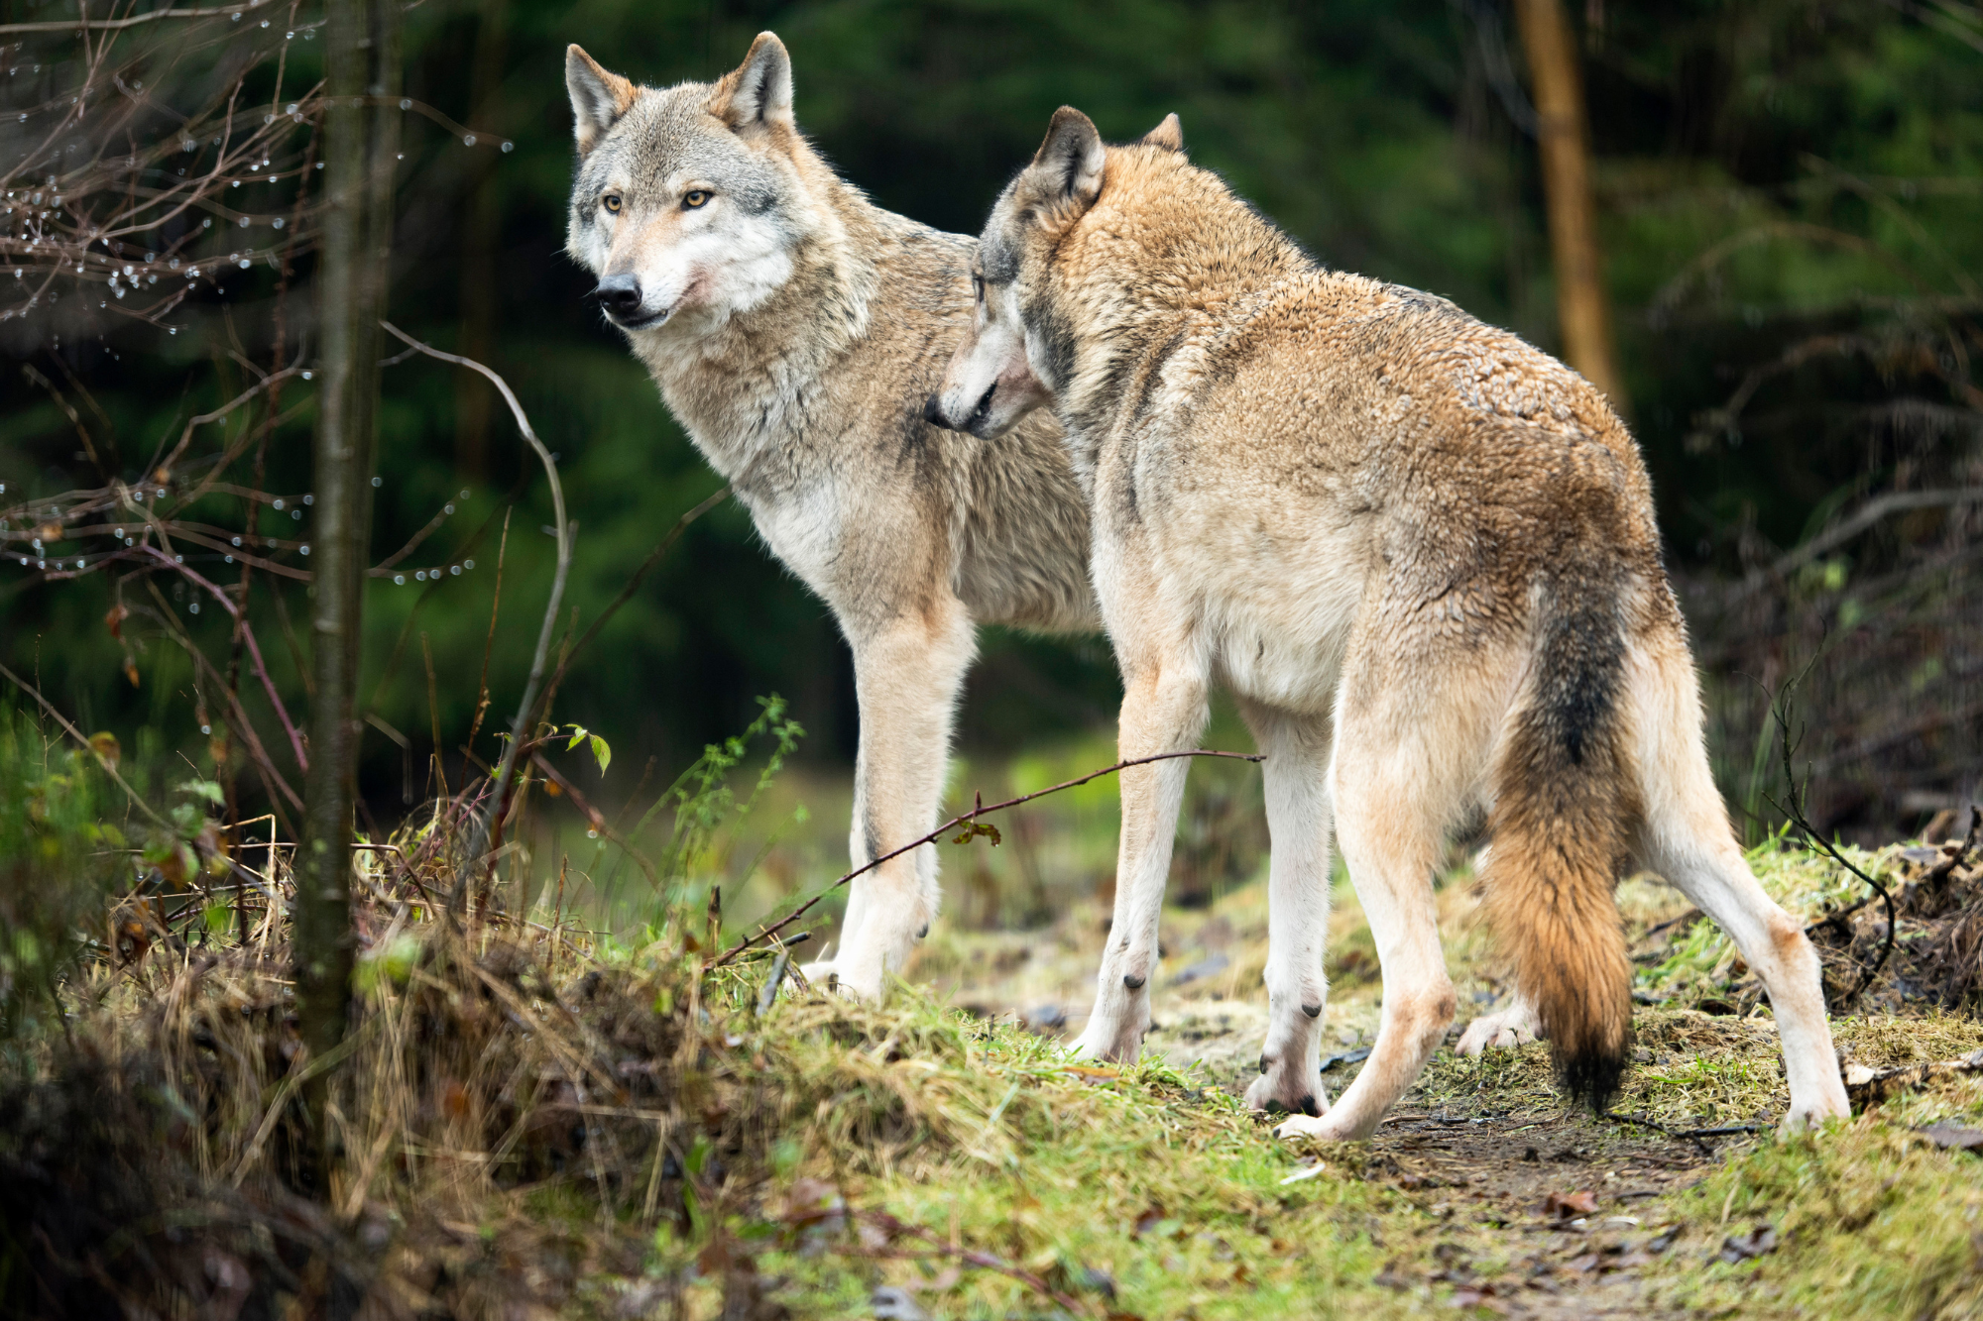
The Two Wolves: A Cherokee Story

Slide 14
An old Cherokee is teaching his grandson about the battle between good and bad. He says, “A fight is going on inside me.” “It is a terrible fight and it is between two wolves. One is evil – he is anger, envy, sorrow, regret, greed, arrogance, self-pity, guilt, resentment, inferiority, lies, false pride, superiority, and ego.” He continued, “The other is good – he is joy, peace, love, hope, serenity, humility, kindness, benevolence, empathy, generosity, truth, compassion, and faith. The same fight is going on inside you – and inside every other person, too.” The grandson thought about it for a minute and then asked his grandfather, “Which wolf will win?” The old Cherokee simply replied, “The one you feed.”

Slide 15
FOUR ways to Feed your spirit
​
*PRAYER
*BIBLE STUDY
*PRAISE AND THANKSGIVING
***FORGIVENESS***

Slide 16
Points on forgiveness 1. must be instant 2. must be given even if not asked for 3. must be given repeatedly- oftentimes for the same offense 4. must become a way of life… practiced daily
“There is no love without forgiveness.”

Slide 17
How spiritual growth improves your physical health 1. studies have shown that prayer and meditation have the ability to bolster your immune system. Prayer can reduce or eliminate stress. 2. studying the word of god gives us wisdom, confidence, and guidance and alleviates our fears.

Slide 18
Forgiveness can lead to: 1. lower blood pressure 2. a stronger immune system 3. improved heart health 4. better quality of sleep 5. less stress – fewer body aches-less arthritis and headaches.
Johns Hopkins study

Slide 19
Signs that you are maturing spiritually
*You desire time alone with the Lord.
*You look for the good in everything.
*You would rather give than receive.
*You care more about what God thinks and less about what others think.
*You have an eye toward Heaven.
*You rely on faith, not fear and feelings.

Slide 20
SUMMARY
As minister wives, we have a great opportunity to influence our church and our communities. If we are going to be all that God has called us to be, we must take care of ourselves both physically and spiritually. Let’s walk…Let’s talk…Let’s take care of ourselves so that we can better take care of others.

Slide 21
God bless YOU!!!
Felice Wicks
Mount Nebo Baptist Church
Jackson, Mississippi

